Slide 1
Third Party Trackers on Law School Library Websites
Tom Boone
Georgetown Law Library
tom@tomboone.com
github.com/tomboone

Slide 2
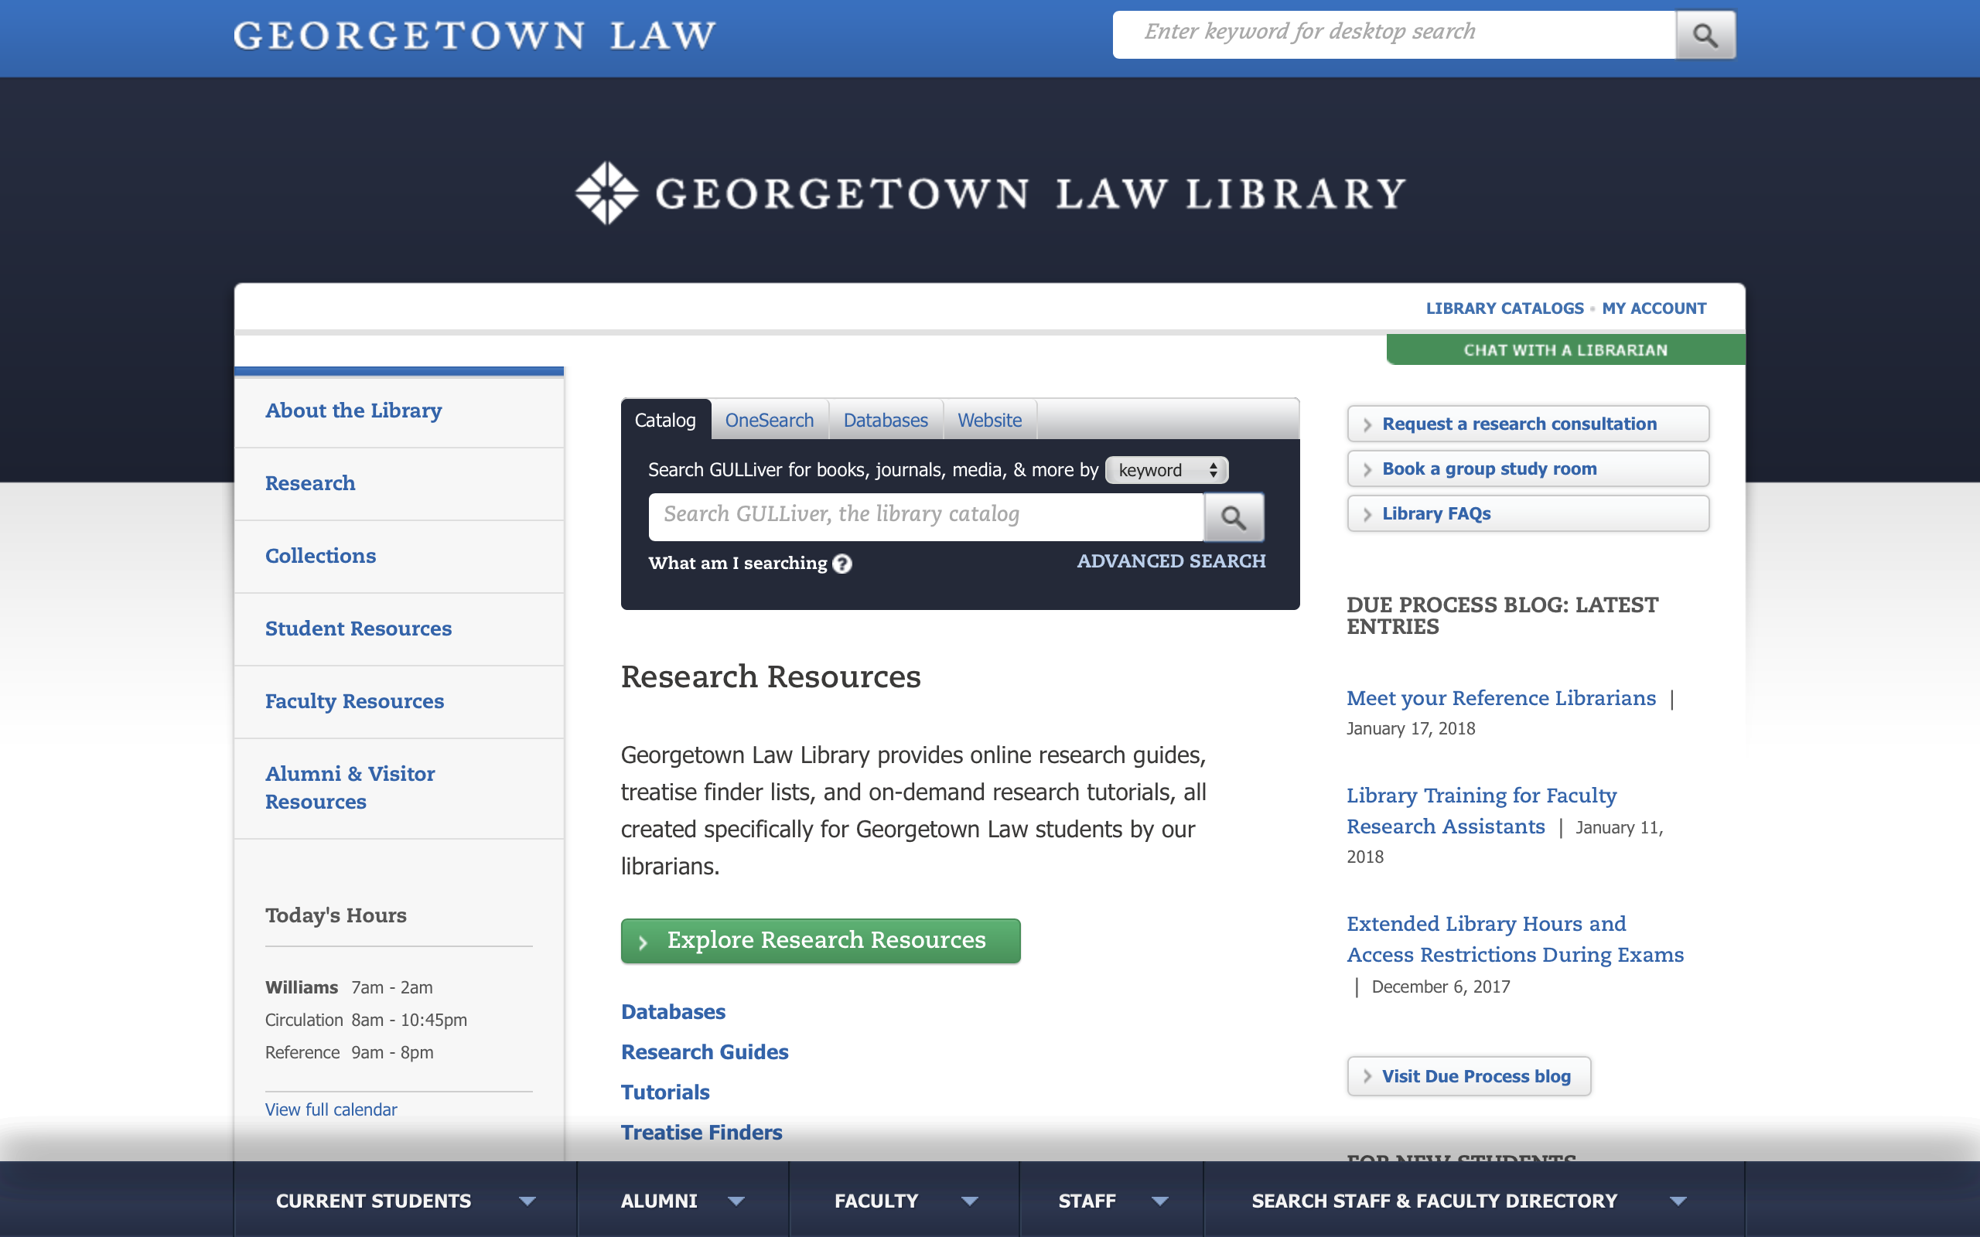

Slide 3


Slide 4
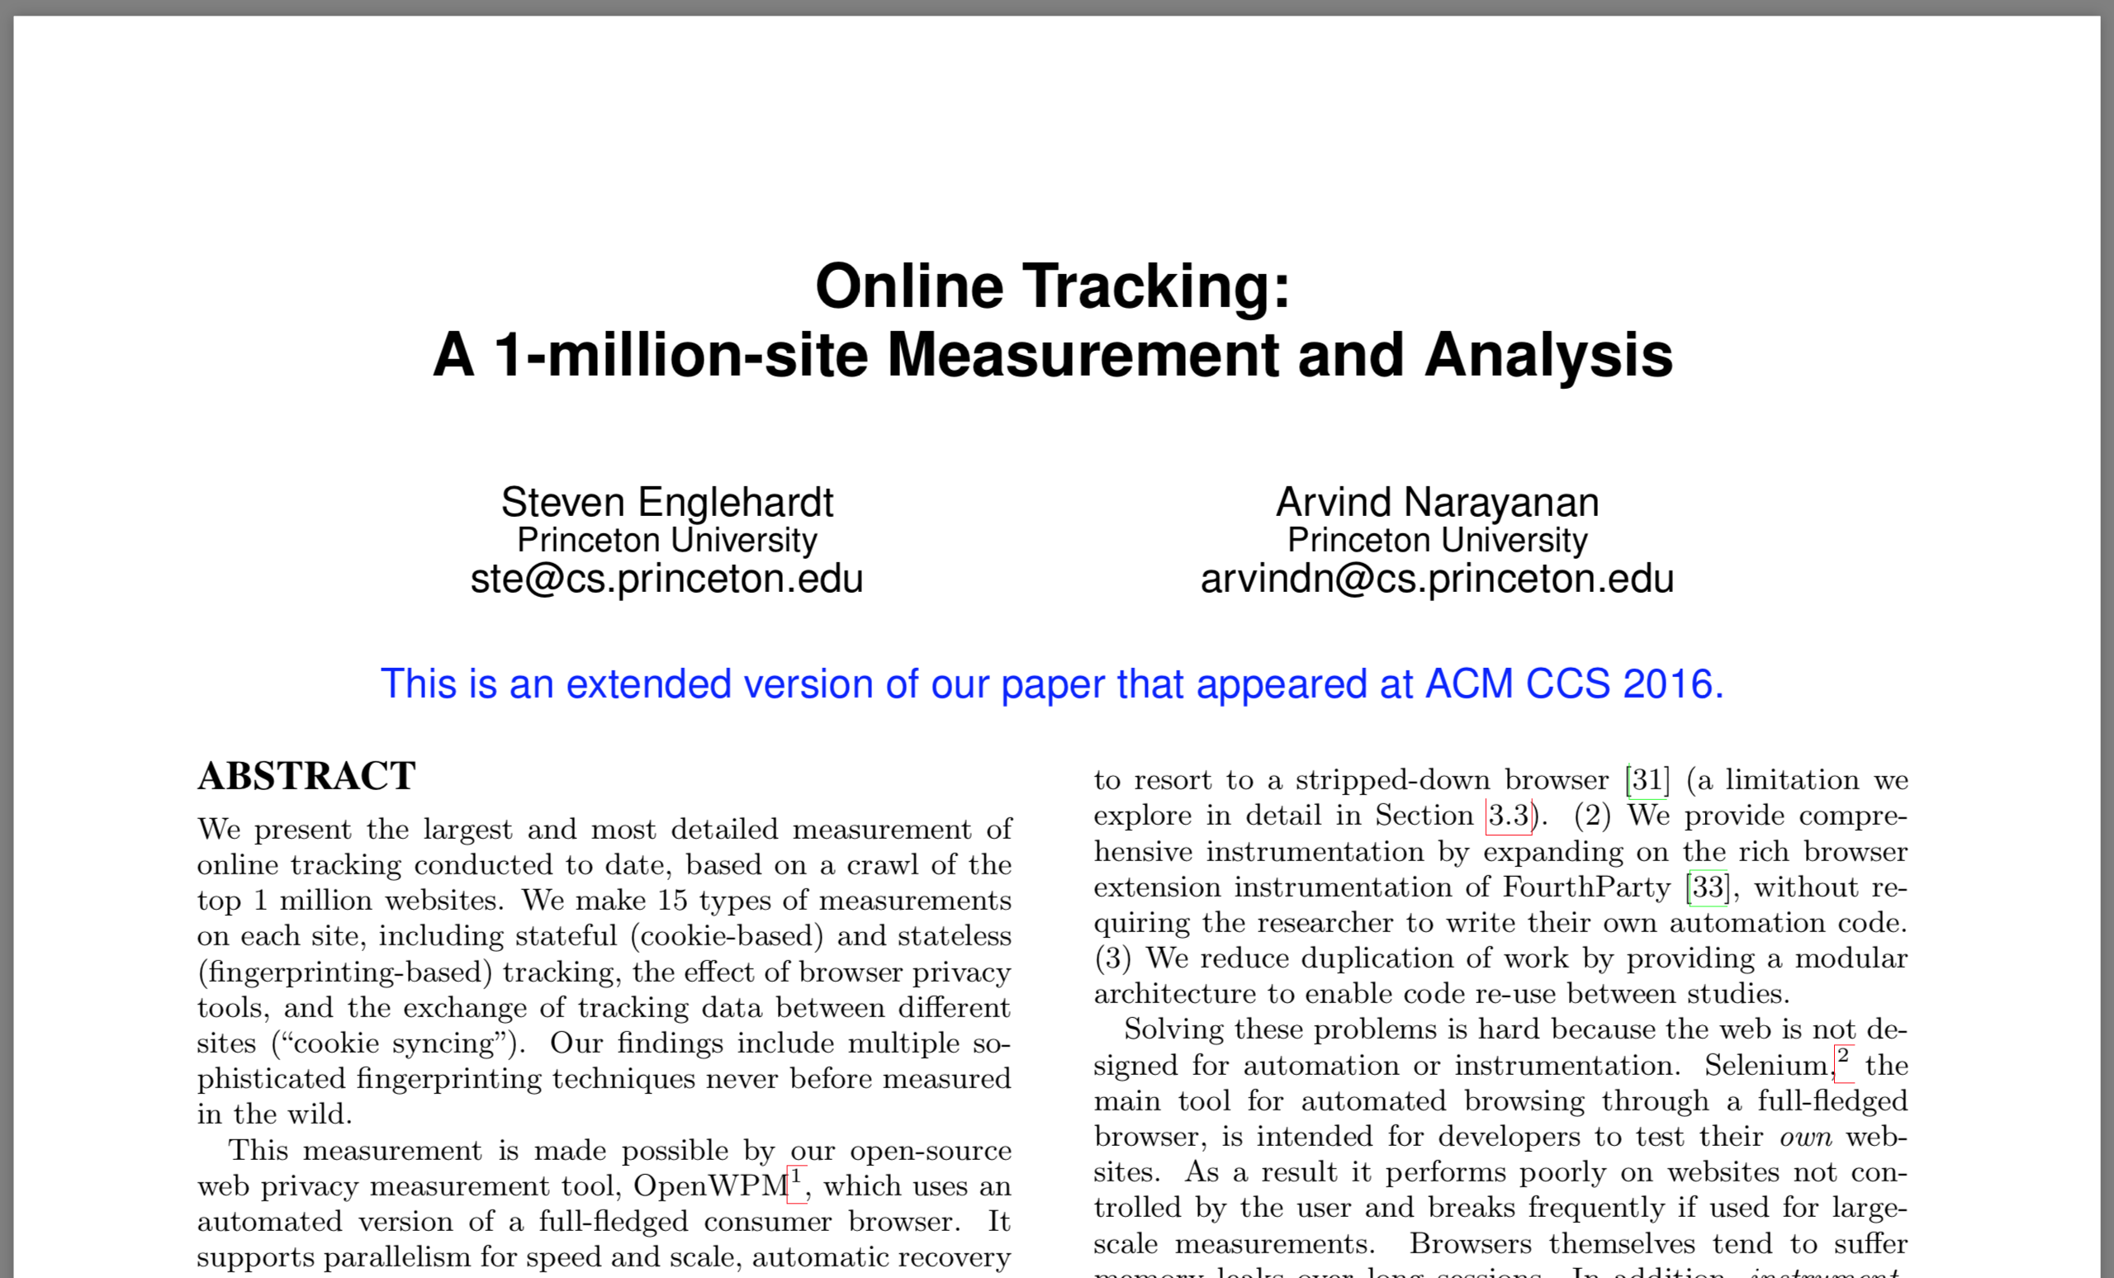

Slide 5
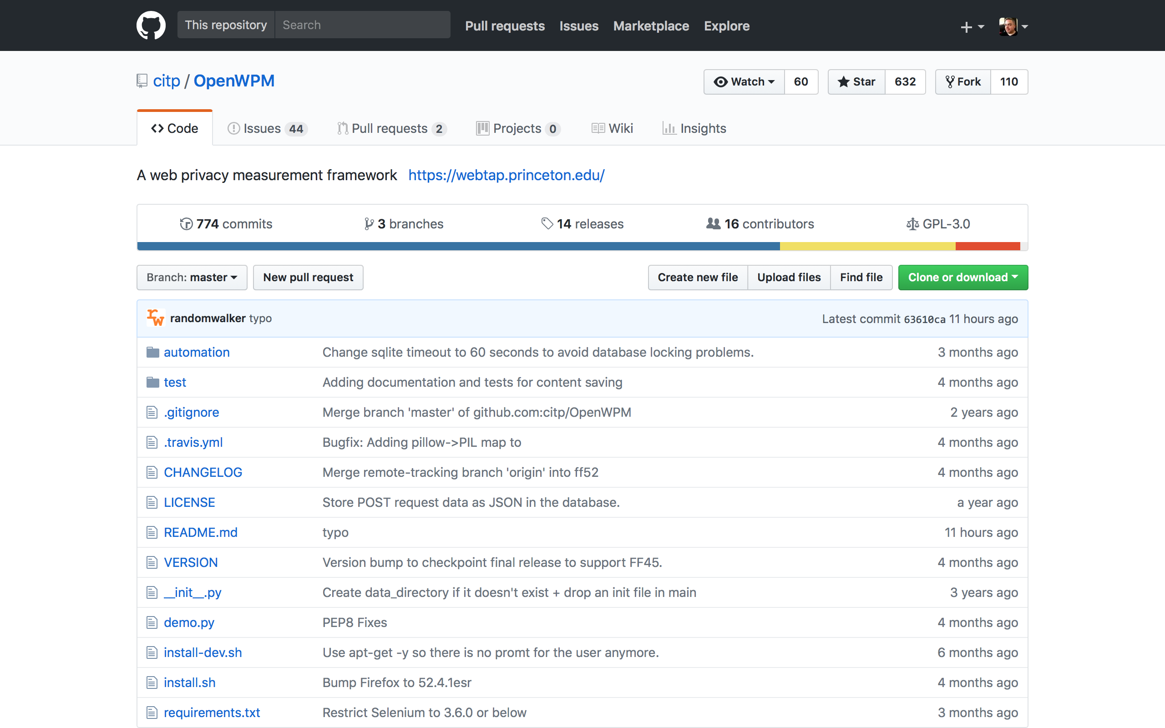

Slide 6
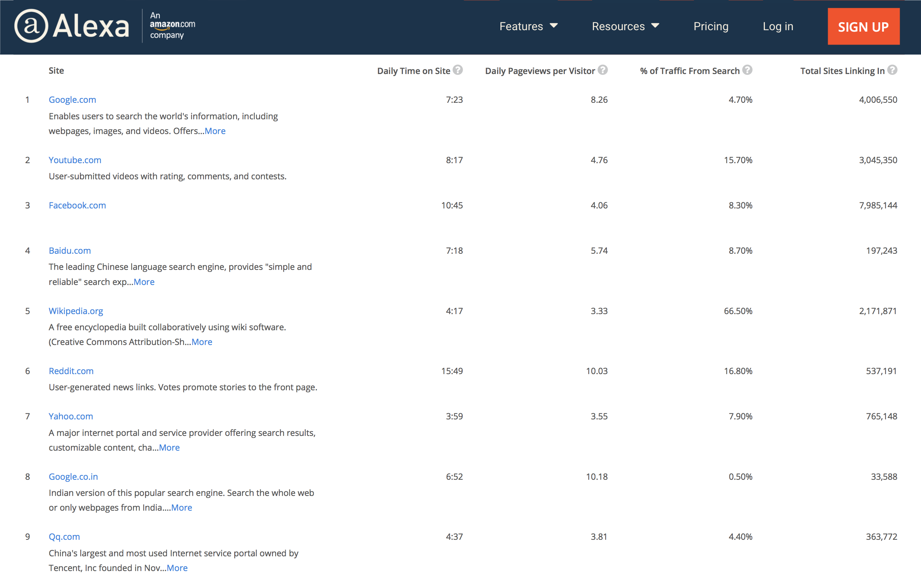

Slide 7
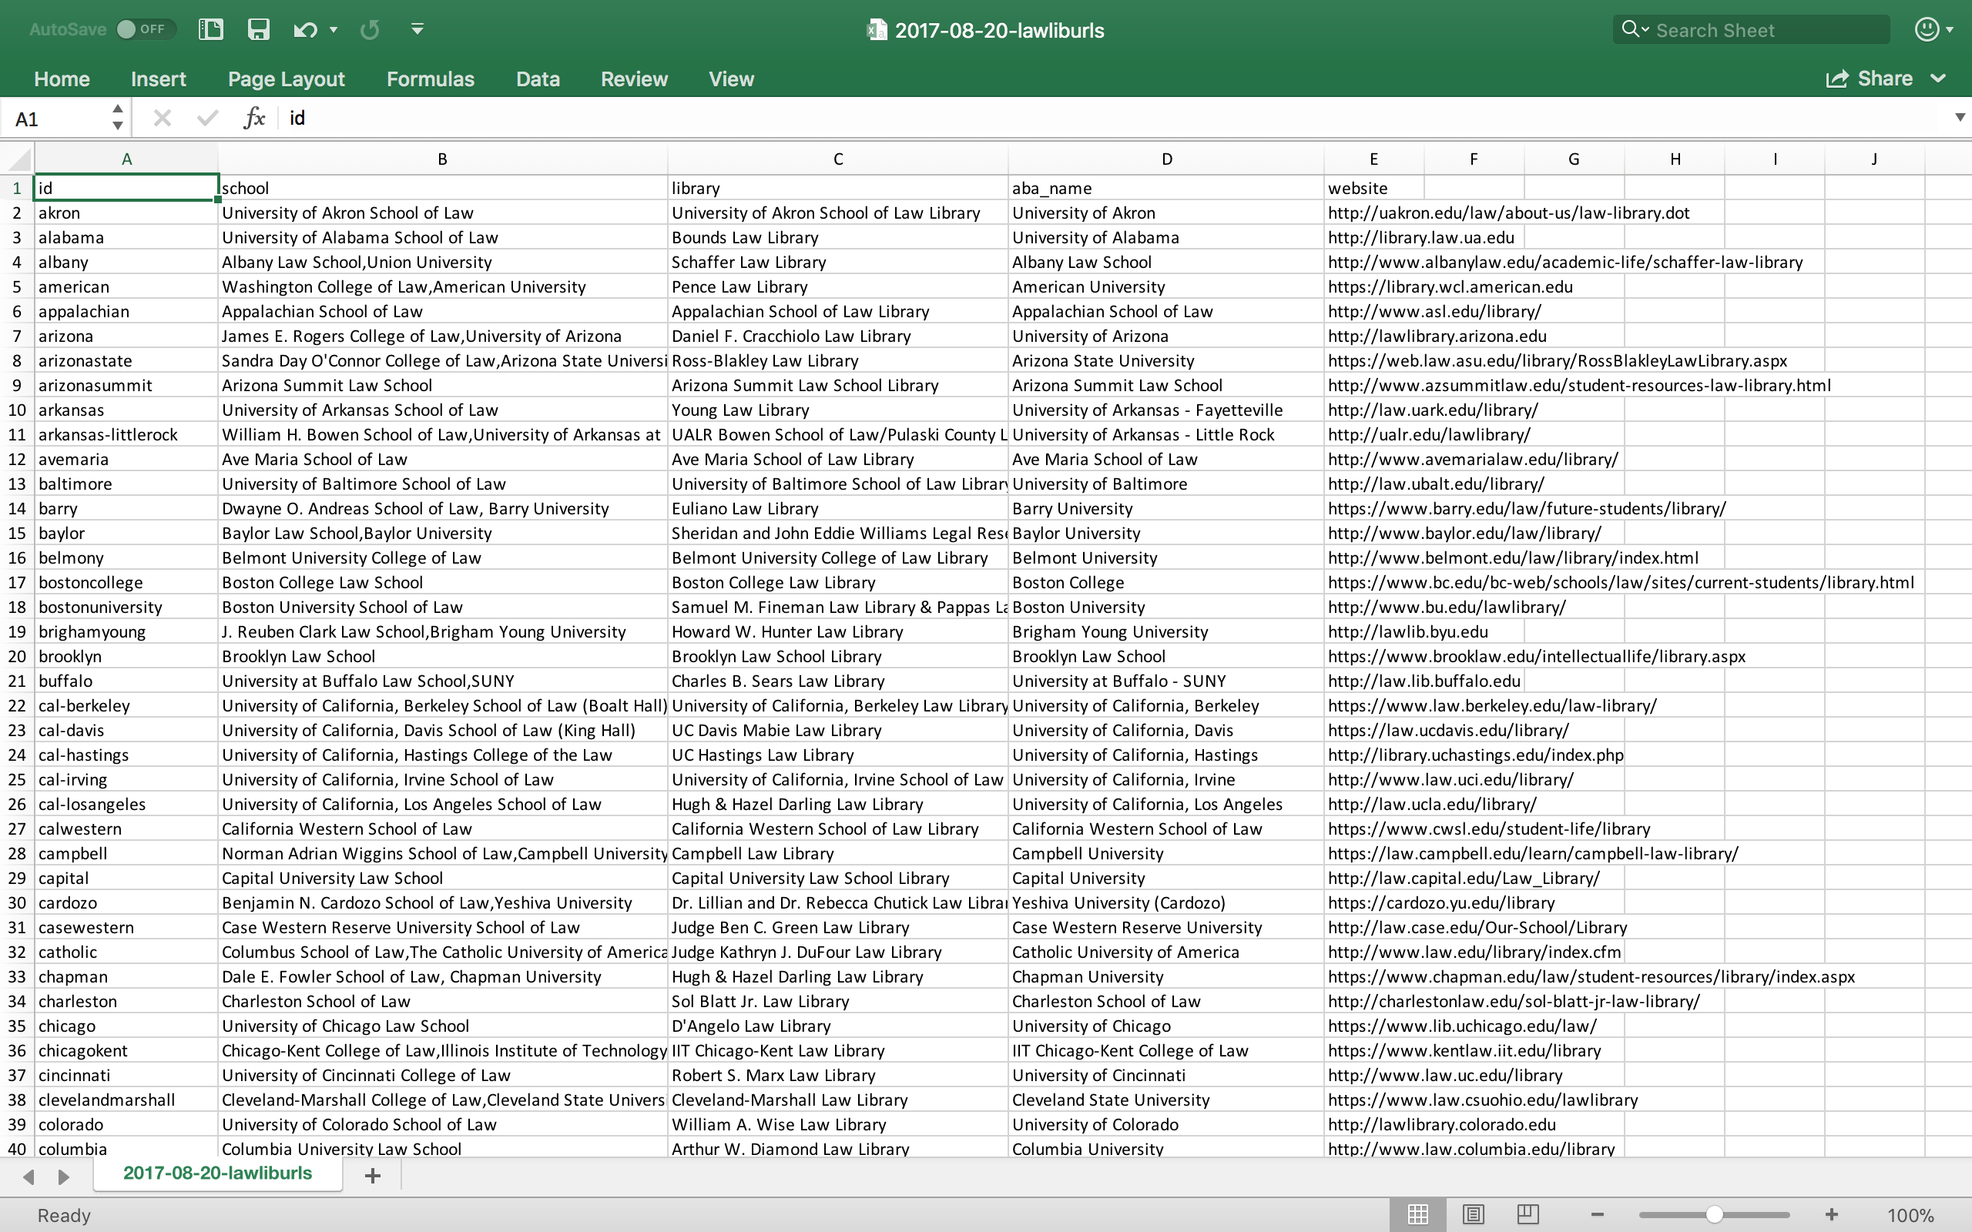

Slide 8
Most 3rd Party HTTP Requests (Avg. Page Load - All Contexts)
1 | Boston College | 195.8
2 | Brigham Young University | 128.1
3 | University of Wyoming | 113.5
4 | Saint Louis University | 105.5
5 | University of the Pacific (McGeorge) | 101.0
6 | Ave Maria School of Law | 96.6
7 | University of Richmond | 96.4
8 | Case Western Reserve University | 90.3
9 | Florida Coastal School of Law | 89.1
10 | University of Pittsburgh | 79.3

Slide 9
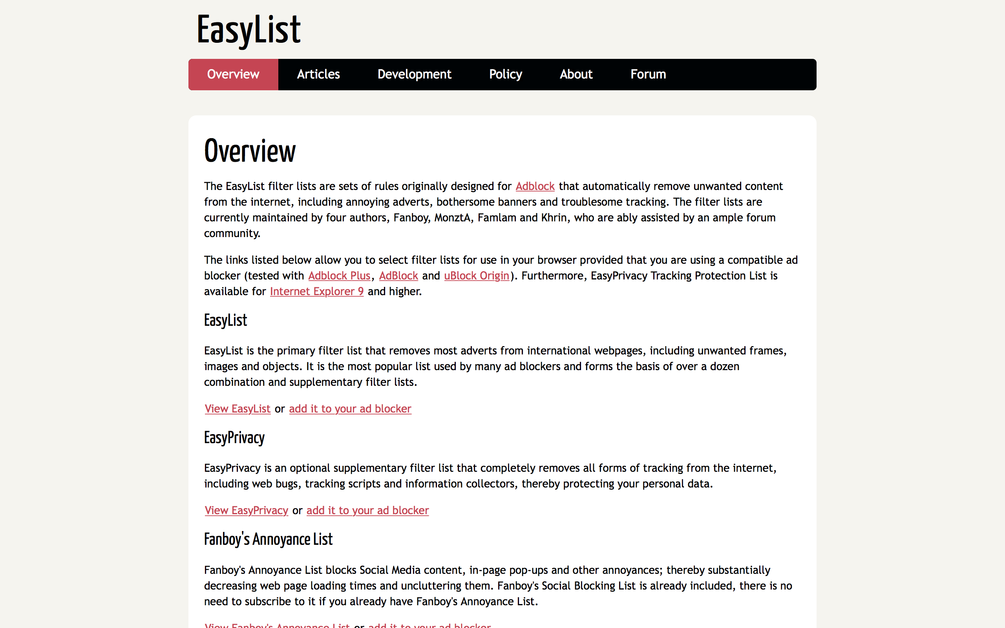

Slide 10
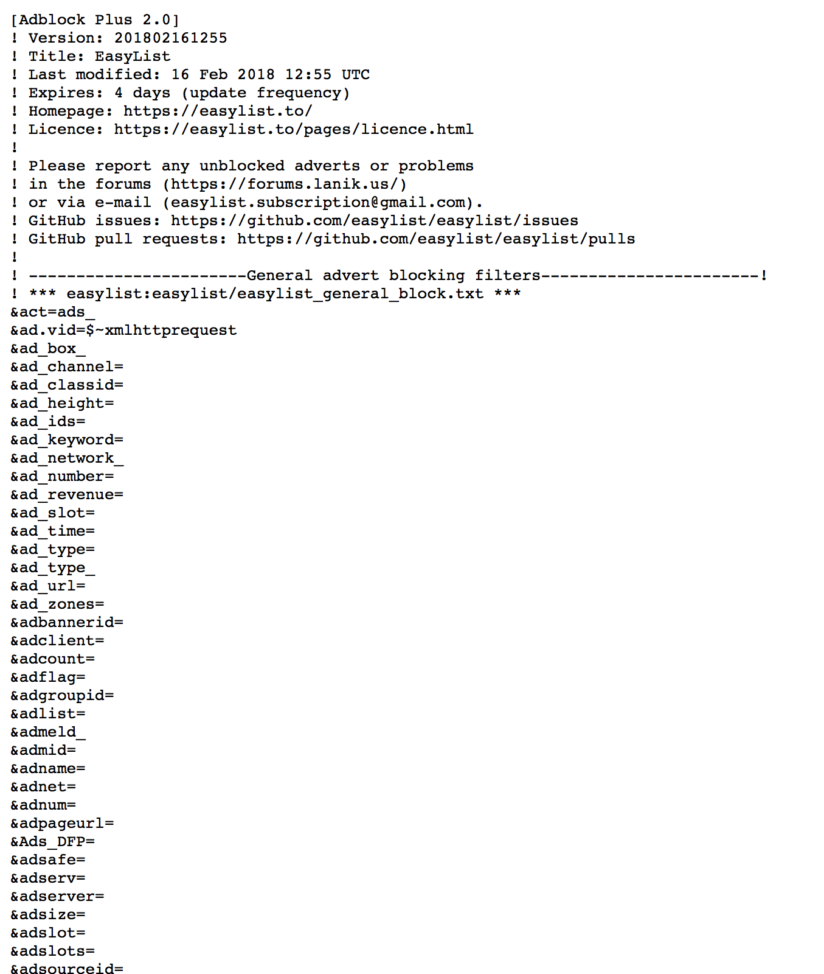

Slide 11
Most 3rd Party HTTP Requests (Avg. Page Load - Tracking Context)
1 | Suffolk University | 29.9
2 | University of the Pacific (McGeorge) | 26.0
3 | University of Pittsburgh | 25.7
4 | Arizona State University | 23.7
5 | Concordia University | 23.1
6 | University of Wyoming | 20.5
7 | Pepperdine University | 20.2
8 | Drexel University | 20.1
9 | Elon University | 19.2
10 | Case Western Reserve University | 19.1

Slide 12
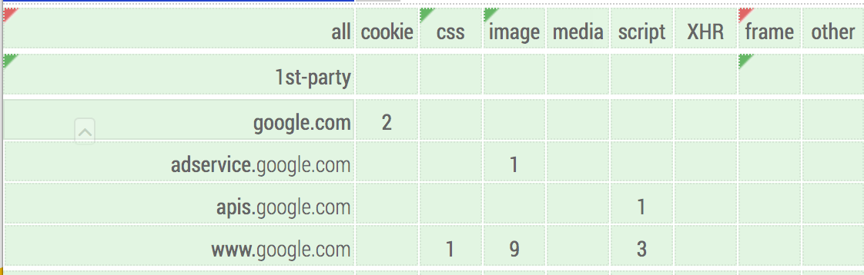

Slide 13
Most 3rd Party Domains Requested (Avg. Page Load - Tracking Context)
1 | University of Pittsburgh | 13
2 | Suffolk University | 12
3 | University of Wyoming | 11
3 | University of the Pacific (McGeorge) | 11
5 | Concordia University | 10
5 | Elon University | 10
7 | Saint Louis University | 9
7 | University of Baltimore | 9
9 | Creighton University | 8
10 | Barry University | 7

Slide 14
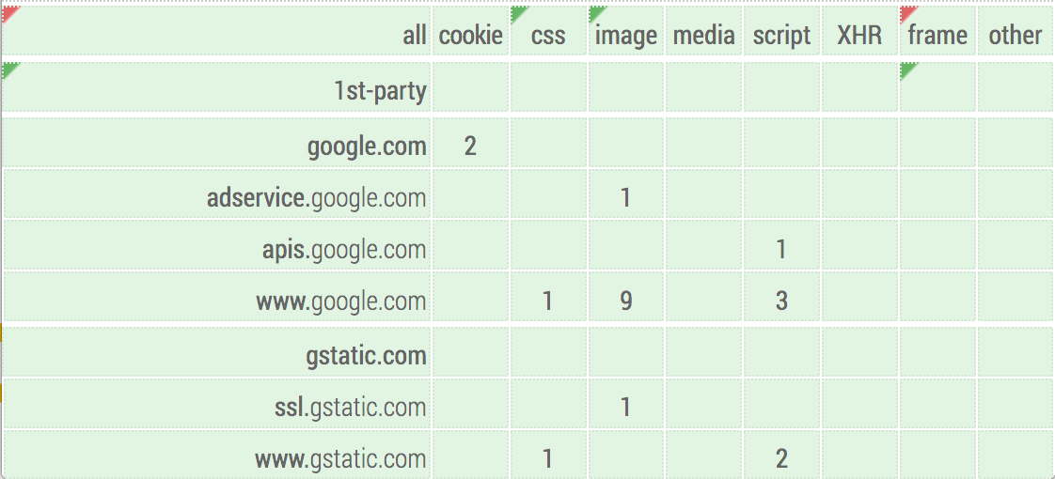

Slide 15
Most 3rd Party Orgs Requested (Avg. Page Load - Tracking Context)
1 | University of Pittsburgh | 10
1 | University of Wyoming | 10
3 | Elon University | 9
3 | Suffolk University | 9
3 | University of the Pacific (McGeorge) | 9
6 | Concordia University | 8
6 | Saint Louis University | 8
8 | Creighton University | 6
8 | University of Baltimore | 6
10 | Barry University | 5

Slide 16
 | Mean | Median
Third Party HTTP Request | 29.5 | 22
Third Party Tracker Requests | 7.32 | 6
Third Party Tracker Domains Requested | 2.99 | 2
Third Party Tracker Orgs Requested | 2.08 | 2

Slide 17
Most Common Domains (Avg. Page Load - All Contexts)
1 | google-analytics.com | 85.9%
2 | googleapis.com | 63.4%
3 | doubleclick.net | 52.2%
4 | google.com | 49.8%
5 | gstatic.com | 42.0%
6 | googletagmanager.com | 35.6%
7 | facebook.com | 31.7%
8 | facebook.net | 30.2%
9 | bootstrapcdn.com | 24.4%
10 | googleadservices.com | 22.9%

Slide 18
Most Common Domains (Avg. Page Load - Tracking Context)
1 | google-analytics.com | 85.9%
2 | doubleclick.net | 51.7%
3 | facebook.com | 30.7%
4 | typekit.net | 15.1%
5 | googleadservices.com | 12.7%
6 | google.com | 11.2%
7 | addthis.com | 8.8%
8 | twitter.com | 8.3%
9 | newrelic.com | 7.8%
10 | addthisedge.com | 6.8%

Slide 19
Most Common Orgs (Avg. Page Load - Tracking Context)
1 | Alphabet | 86.8%
2 | Facebook | 30.7%
3 | Adobe | 16.1%
4 | Oracle | 8.8%
5 | Twitter | 8.3%
6 | New Relic | 7.8%
7 | LinkedIn | 6.3%
8 | Amazon | 5.4%
9 | AppNexus | 4.4%
10 | Verizon | 3.4%

Slide 20
Most 3rd-party cookies set (Avg. Page Load)
1 | University of Wyoming | 55
2 | Suffolk University | 53
3 | Vermont Law School | 46
4 | University of the Pacific (McGeorge) | 43.5
5 | Saint Louis University | 37
6 | IIT Chicago-Kent College of Law | 35
7 | Loyola University Chicago | 34
7 | University of Pittsburgh | 34
9 | Capital University | 33
10 | Albany Law School | 30.5

Slide 21
Most 3rd-party cookie domains (Avg. Page Load)
1 | University of Wyoming | 20
2 | Suffolk University | 15
2 | University of the Pacific (McGeorge) | 15
4 | IIT Chicago-Kent College of Law | 12
5 | Saint Louis University | 11
6 | University of Pittsburgh | 10
7 | Elon University | 9
8 | Concordia University | 8
8 | Loyola University Chicago | 8
10 | Barry University | 7

Slide 22
Most 3rd-party cookie orgs (Avg. Page Load)
1 | University of Wyoming | 17
2 | Suffolk University | 14
3 | University of the Pacific (McGeorge) | 12
4 | IIT Chicago-Kent College of Law | 11
4 | Saint Louis University | 11
6 | Concordia University | 8
6 | Elon University | 8
6 | University of Pittsburgh | 8
9 | Barry University | 6
9 | Loyola University Chicago | 6
9 | Southwestern University | 6
9 | Stetson University | 6
9 | University of Akron | 6
9 | Vermont Law School | 6

Slide 23
Most common 3rd-party cookie domains (Avg. Page Load)
1 | doubleclick.net | 34.6%
2 | google.com | 32.7%
3 | facebook.com | 24.4%
4 | adnxs.com | 9.8%
5 | addthis.com | 9.3%
5 | cloudflare.com | 9.3%
5 | twitter.com | 9.3%
8 | newrelic.com | 7.3%
9 | adsrvr.org | 6.8%
9 | linkedin.com | 6.8%

Slide 24
Most common 3rd-party cookie domains (Avg. Page Load)
1 | doubleclick.net | 34.6%
2 | google.com | 32.7%
3 | facebook.com | 24.4%
4 | adnxs.com | 9.8%
5 | addthis.com | 9.3%
5 | cloudflare.com | 9.3%
5 | twitter.com | 9.3%
8 | newrelic.com | 7.3%
9 | adsrvr.org | 6.8%
9 | linkedin.com | 6.8%

Slide 25
Most common 3rd-party cookie orgs (Avg. Page Load)
1 | Alphabet | 51.2%
2 | Facebook | 24.4%
3 | AppNexus | 9.8%
4 | Cloudflare | 9.3%
4 | Oracle | 9.3%
4 | Twitter | 9.3%
7 | Verizon! | 8.4%
8 | New Relic | 7.3%
9 | LinkedIn | 6.8%
9 | The Trade Desk | 6.8%

